Slide 1
Shell Bootcamp 2024 – TECHNICAL FOUNDATION Reflections for Day 4 (03-Sep-2024)
Hitesh
Date : 06-Sep-2024

Slide 2

My learnings from this week!

Slide 3
Learning 1 | My takeaways
What is DevOps?
DevOps is a set of practices that combine software development (Dev) and IT operations (Ops) to shorten the development lifecycle and deliver high-quality software continuously. It focuses on automation, collaboration, and continuous improvement.
History of DevOps
DevOps evolved from Agile and Lean practices, emerging in the late 2000s to address the growing need for faster and more reliable software delivery. It bridges the gap between development and operations teams.
Types of Environments in Software Development
Central Development: The initial environment where developers write and test code.
Test Environment: Includes Performance Test and Feature Test environments where the code is rigorously tested.
Pre-Production (Staging Phase): A replica of the production environment where final testing occurs.
Production: The live environment where the final product is deployed for users.
Why DevOps?
DevOps is crucial for streamlining processes across the software development lifecycle, aligning the needs of customers, development, testing, and operations teams.
DevOps Fills the Gap
DevOps eliminates the disconnect between development and operations teams by fostering collaboration, leading to faster and more reliable software delivery.
DevOps Life Cycle
The DevOps lifecycle includes stages like planning, building, continuous integration, deployment, monitoring, and continuous feedback, optimizing the development process.

Slide 4
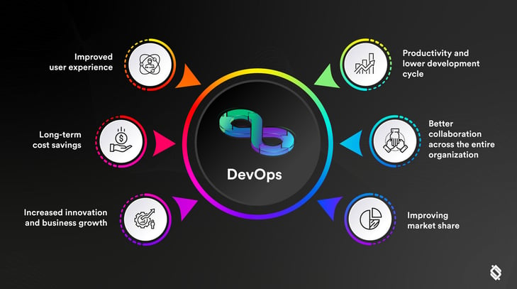
Learning 1 | My takeaways

Slide 5
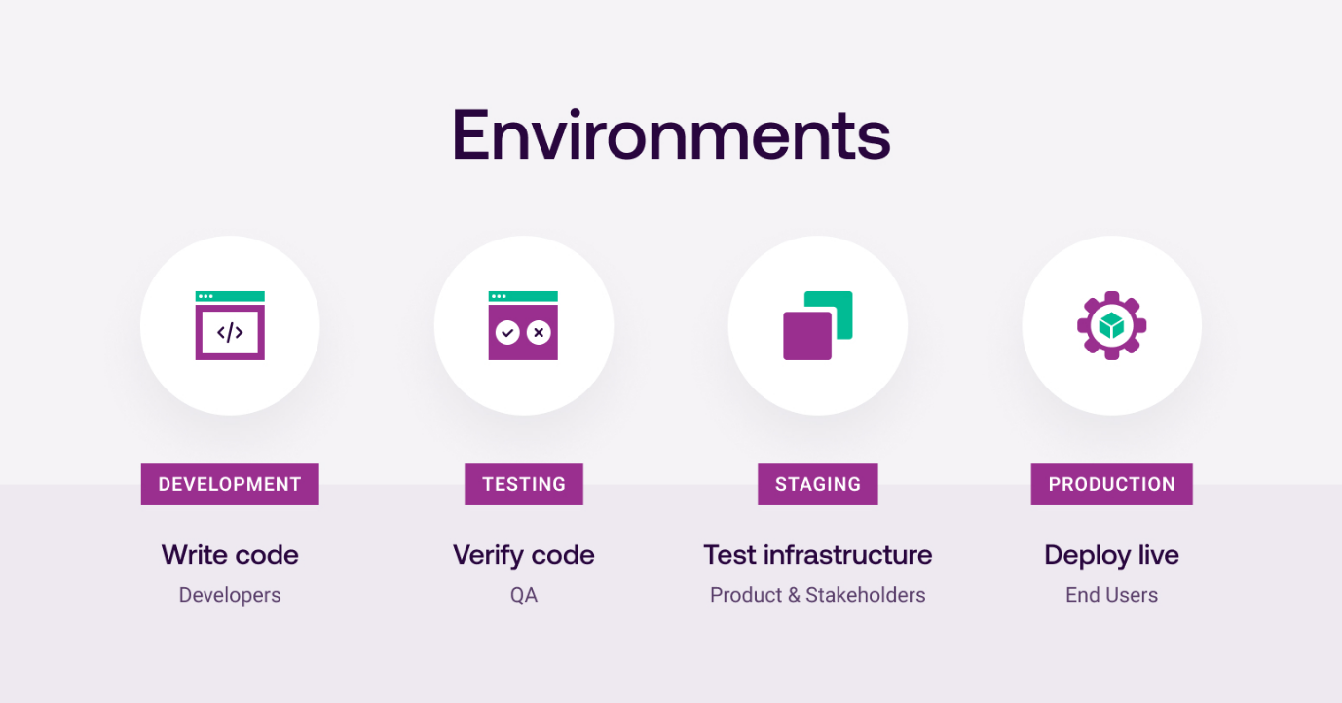
Learning 1 | My takeaways

Slide 6
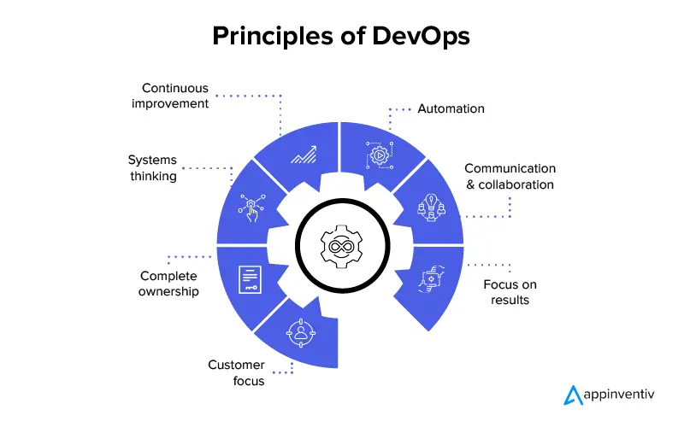
Learning 2 | My takeaways
DevOps Principles
Automation: Automating repetitive tasks to increase efficiency.
Iteration: Repeated cycles of development and testing for continuous improvement.
Continuous Improvement: Constantly enhancing processes and products.
Collaboration: Ensuring effective communication and teamwork across all involved parties.
Benefits of DevOps
Faster Time to Market: Speed up the release cycle.
Higher ROI: Efficient processes lead to better returns.
Easy Rollback: Quickly revert changes if needed.
Greater User Satisfaction: Continuous improvement ensures a better product.

Slide 7
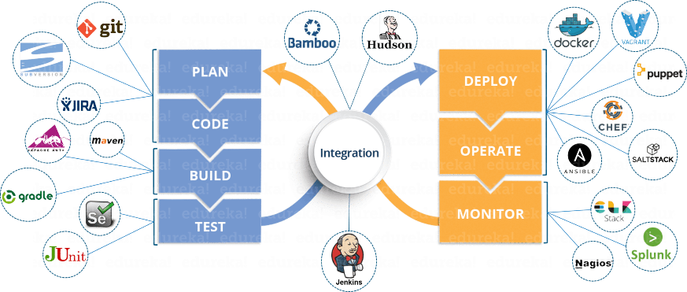
Learning 3 | My takeaways
DevOps Tools
Plan: Tools like Jira help manage and plan tasks.
Build: Tools like Maven and Gradle for building code.
Continuous Integration and Deployment: Jenkins, GitHub Actions for automating testing and deployment.
Monitor: Nagios, Prometheus for system monitoring.
Operate: Docker, Kubernetes for managing applications in production.
Continuous Feedback: Tools like Grafana for collecting and analyzing feedback.
Continuous Integration and Continuous Delivery (CI/CD)
CI/CD is a set of practices that automate the process of software development, testing, and deployment.
CI focuses on integrating and testing code changes frequently.
CD extends this by automating the deployment of code to production environments, ensuring that new features and fixes are delivered quickly and reliably.

Slide 8
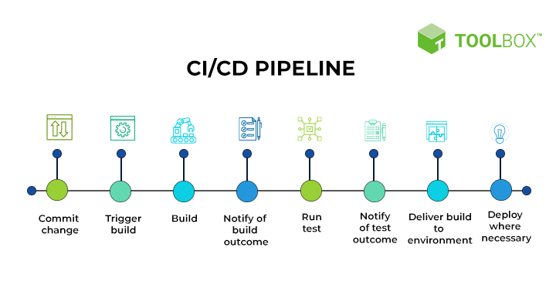
Learning 3 | My takeaways

Slide 9
Learning 4 | My takeaways
Importance of CI
Reduces Risk: Early detection of issues.
Better Communication: Ensures all team members are aligned.
Higher Product Quality: Frequent testing leads to a more reliable product.
GitHub as a Code Repository
GitHub is a platform for hosting and managing code repositories, facilitating collaboration among developers.
What is GitHub Actions?
GitHub Actions is a CI/CD platform that automates the build, test, and deployment pipeline. It allows developers to define workflows directly within their GitHub repository.
Components of GitHub Actions
Workflows: Automated processes defined by YAML files, triggered by events in the repository.
Events: Activities in the repository, such as push, pull request, or issue creation, that trigger workflows.
Jobs: A series of steps executed as part of a workflow.
Actions: Reusable commands that are combined to create jobs.
Runners: Servers that execute the workflow jobs.
Understanding YAML for GitHub Actions
YAML is a human-readable data format used to define GitHub Actions workflows. It specifies the sequence of jobs, steps, and actions that make up the CI/CD pipeline.

Slide 10
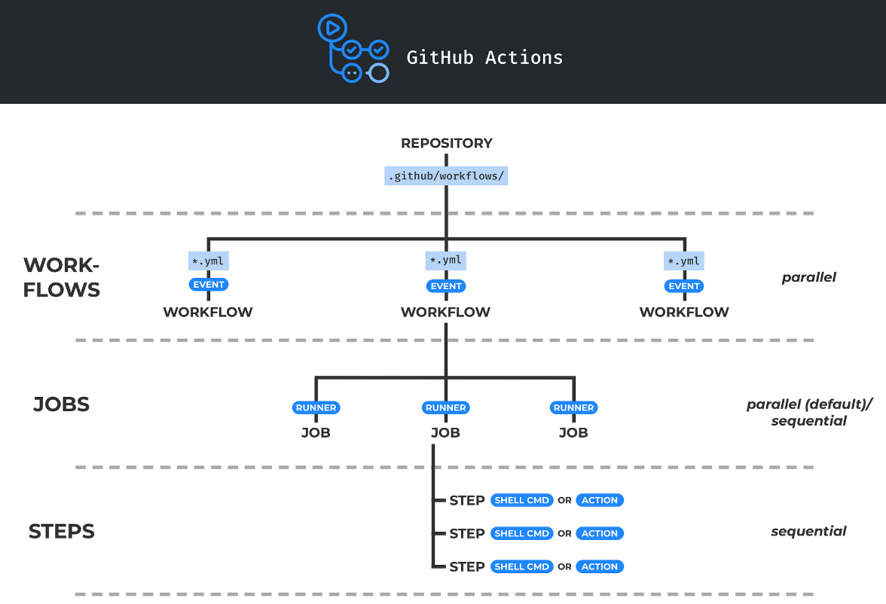
Learning 4 | My takeaways

Slide 11
Thank You

